Slide 1

Air Pollution Project
By Tooba, Ash, Musab, Shabana and Ayroza
Notes:
The projects looks at the air quality index pollution levels worldwide. To do this we have created an interactive dashboard displaying air pollution levels worldwide. The aim is to uncover trends in air quality and identify possible reasons/causes of disparity. The results will be presented using a collaboration of data sources using languages in SQL, HTML charts and API Maps to show the varying demographics within the data, whilst providing information on our processes for Data sources, Data Retrieval, Data Cleansing, Data Exploring via SQL and understanding the Data Sets. This will be followed by the data interactive tools that have been built using the tools.

Slide 2

Causes of Air Pollution
Notes:
Air pollution is caused by solid & liquid particles as well as certain gases that are suspended in the air. These particles and gases can come from industrial facilities, car and truck exhausts, Dust from construction sites, landfills and agriculture; pollen, mold spores, volcanoes and wildfires to name a few causes.

Slide 3
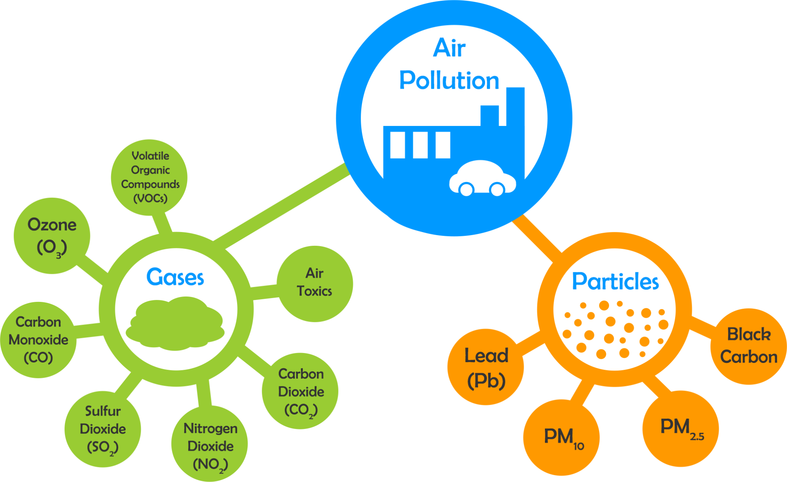
Air Pollution Gases
There are 5 Major Air Pollutants
•Particulate Matter.
•Carbon Monoxide.
•Ozone.
•Nitrogen Oxides.
•Sulfur Dioxide.
Other Air Pollutants include Lead, Air Toxics and Volatile Organic Compounds
Notes:
There are 5 major pollutants which contribute to Air Pollution globally
Particulate matter (PM10 and PM2) is a common proxy indicator for air pollution. There is strong evidence for the negative health impacts associated with exposure to this pollutant. The major components of PM are sulfates, nitrates, ammonia, sodium chloride, black carbon, mineral dust and water.
Carbon monoxide (CO) is colourless, odourless and tasteless produced fuels such as wood, petrol, charcoal, natural gas and kerosene.
Ozone (O3) is a Ground-level gas that forms just above the earth's surface.
Nitrogen dioxide (NO2) commonly released from the combustion of fuels in the transportation and industrial sectors.
And Sulfur dioxide (SO2)is produced from the burning of fossil fuels (coal and oil) .
The varying global levels of air pollutants are tracked using the Air Quality Index.

Slide 4
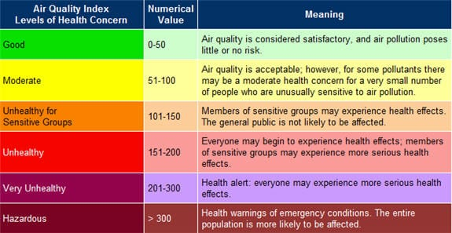
What is Air Quality Index (AQI)
Notes:
The Air Quality Index or AQI monitors the pollutant levels and provides health advice in accordance to the level of air pollution.
The index is numbered 0-500, where the higher the AQI value, the greater the level of air pollution and the greater the health concern.
An AQI value of 50 or below represents good air quality, while an AQI value over 300 represents hazardous air quality.

Slide 5
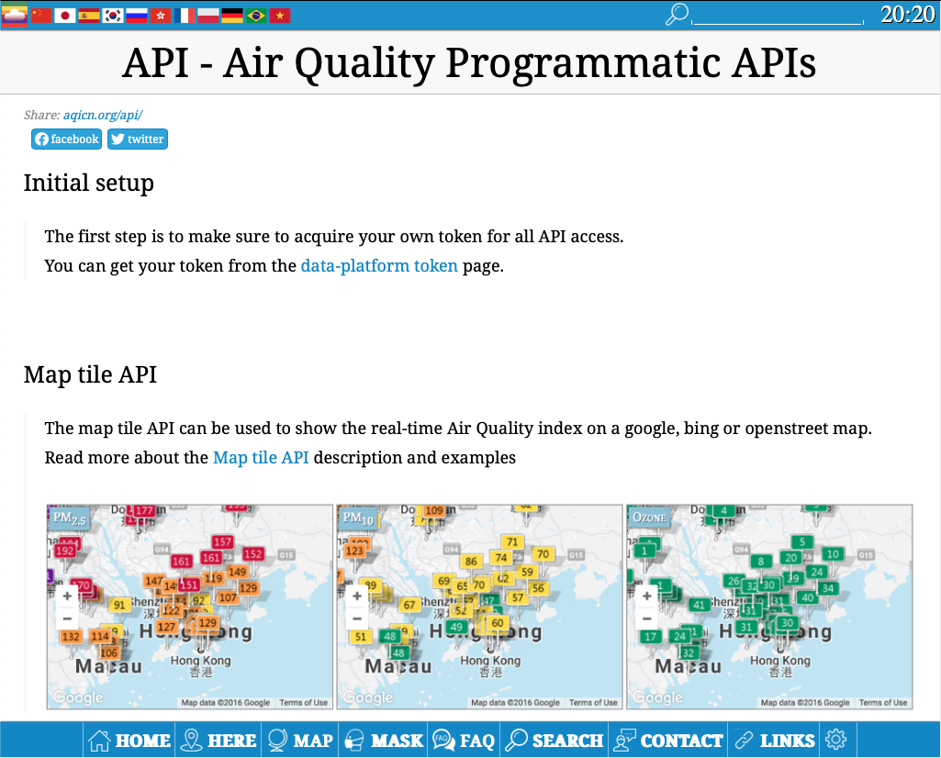
Data Source
AQICN
Data platform providing real-time air quality data
API format
Provides latitude/longitude, global Air Quality Index (AQI) and pollutant information for stations all over the globe
By setting bounds to maximum latitude and longitude limits, global data can be collected
url = https://api.waqi.info/v2/map/bounds?latlng=-90,-180,90,180&networks=all&token={token}
Notes:
The source of our data was an online air quality data platform called AQICN. Their APIs return latitude and longitude coordinates of stations, the AQI of the region and some even return detailed pollutant information.
The API that we chose returned all stations within latitude and longitude bounds. We initially set these to the bounds of the UK, but found that there was very little variation in AQI across the country. We therefore decided to set our bounds to the maximum latitude and longitude values so that global air quality data was returned.

Slide 6
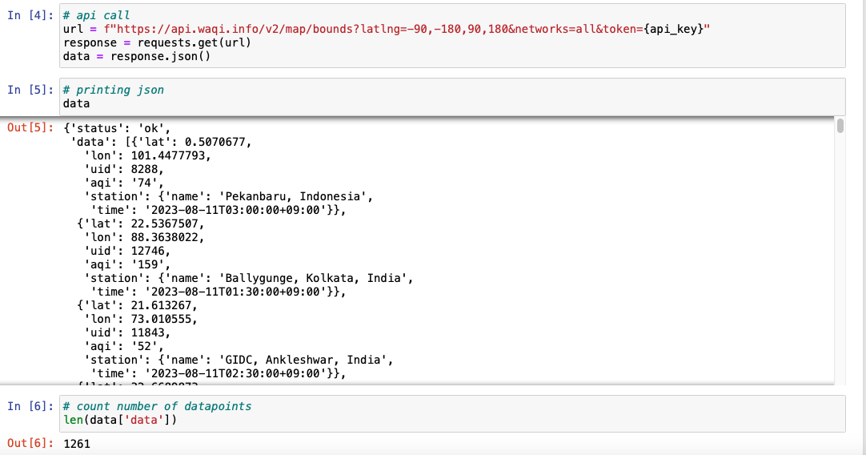

Data Retrieval
Notes:
To retrieve the data we used the requests library to make an API call. The response contained data for over 1200 stations.

Slide 7
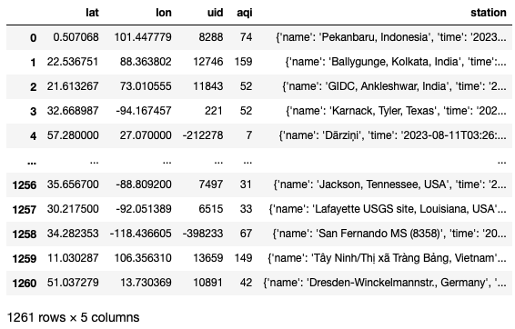
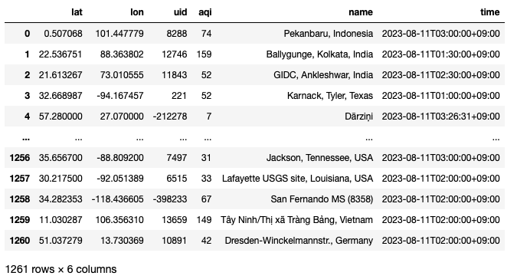
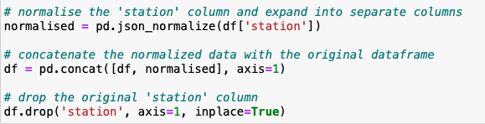
Data Cleansing (1)
Notes:
The data was converted to a Pandas DataFrame but needed to be cleansed before it was ready for analysis.
The data in the station column was still in dictionary format so we used the json normalise function to split this into name and time.

Slide 8
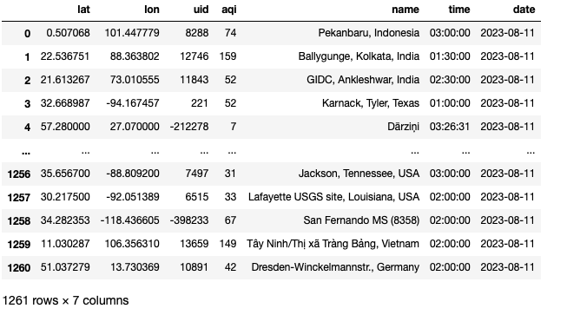
Data Cleansing (2)
Notes:
The time column was then split further to separate the time and the date.

Slide 9
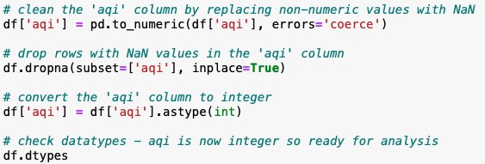
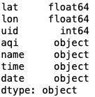
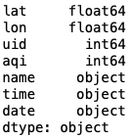
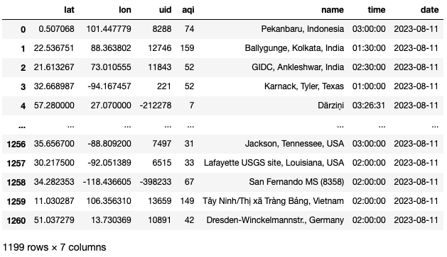
Data Cleansing (3)
Final DataFrame exported as CSV and JSON:
Notes:
Upon inspecting the datatypes, we saw that the AQI column datatype was showing as an object.
Since we would later need this for analysis, it was converted to an integer.
Finally, the DataFrame was exported as both a CSV file and a JSON file.

Slide 10
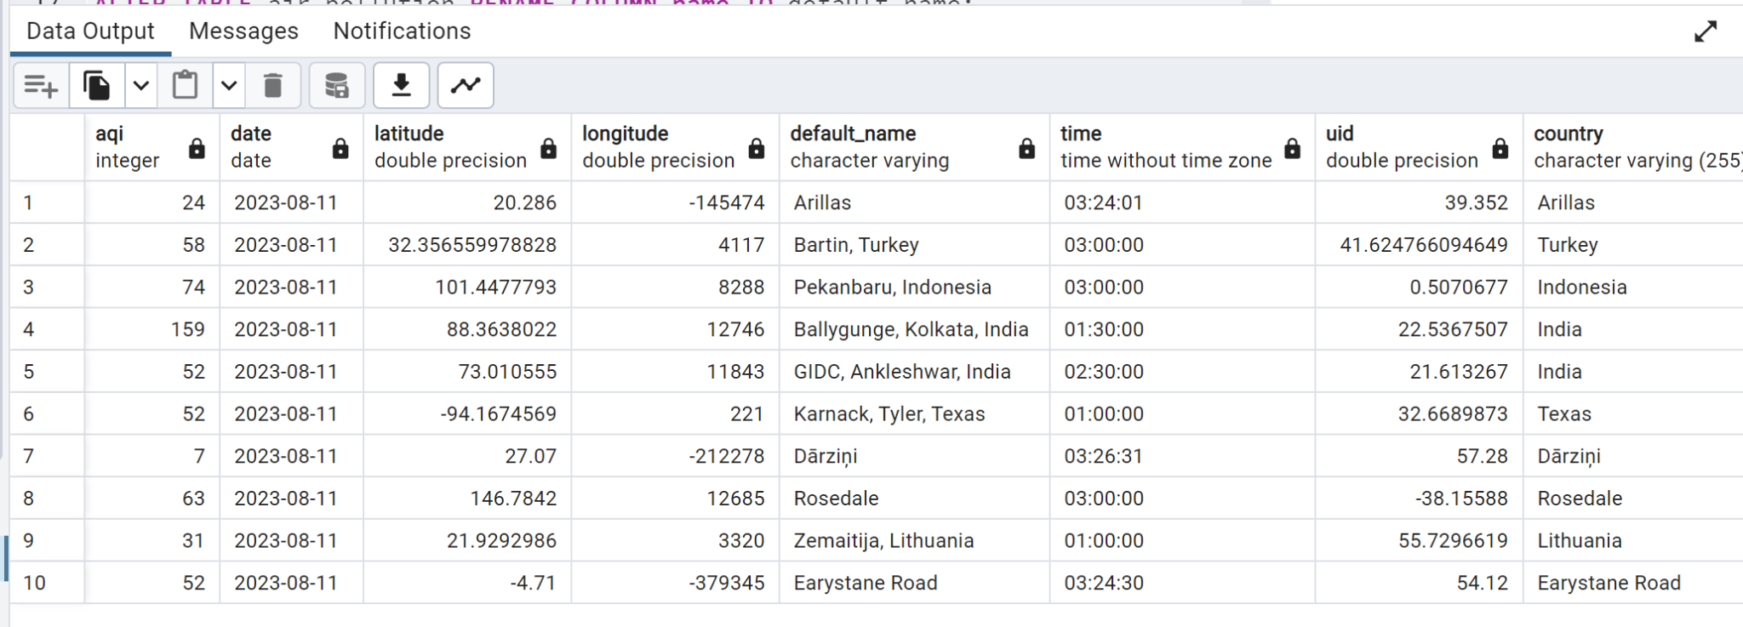
Exploring Air Pollution Data with
SQL Queries
In this part of the presentation, we delve into our analysis of air pollution using SQL queries. Our goal is to uncover trends, patterns, and insights from the air pollution dataset.
Notes:
In order to query our data, we started by importing the data from a CSV file into our SQL database.
Our focus whilst querying the data was on identifying significant patterns, finding out air quality trends, and gaining an insight into the impact of pollution.
Our aim from doing all of this is to better understand how air pollution affects health, the environment, and see if we can make policy-making decisions with this.

Slide 11
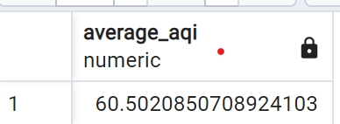
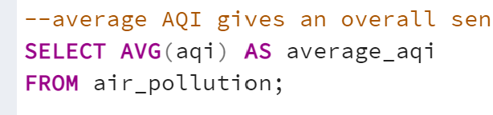
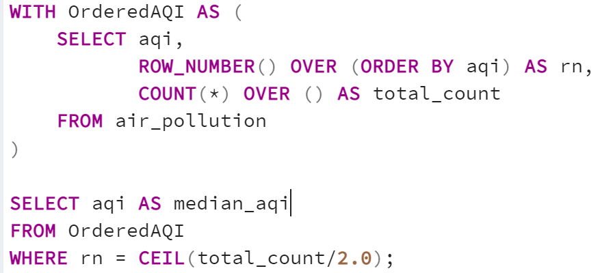
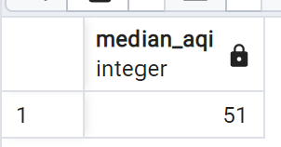
Understanding Dataset Quality
In this section, we delve into essential air quality measures to assess the reliability of our dataset.
Notes:
We did a query to examine whether or not our data is good, our calculated average and median in our dataset was 60 and 51, this proximity suggests that our dataset is not only consistent but also well-distributed across a spectrum of air quality levels.
The harmony between the average and median AQI values indicated that our data isn't skewed by extreme outliers that could distort our findings.

Slide 12
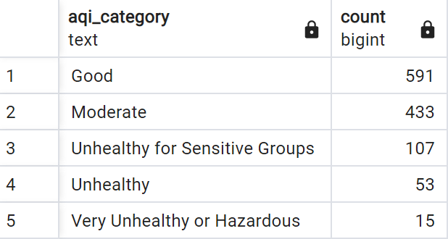
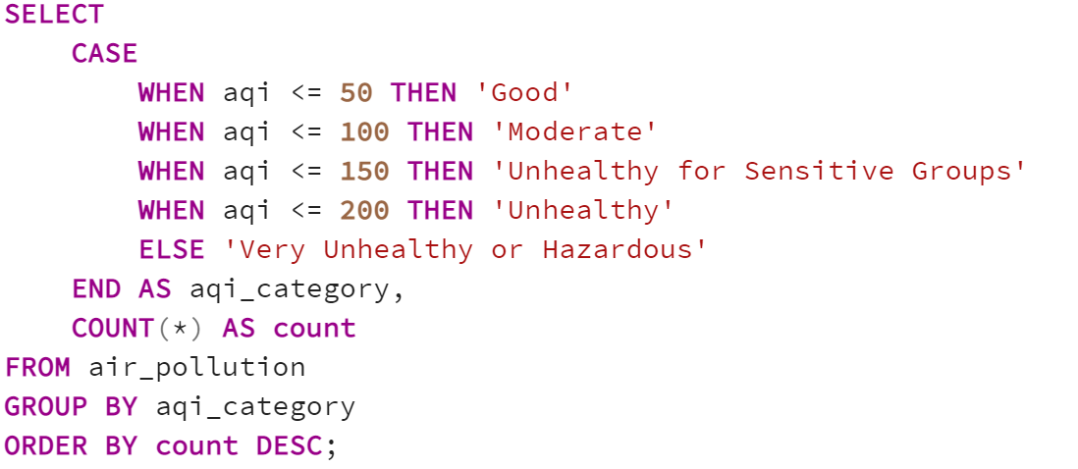
Understanding Pollution Severity with SQL
In this section, we are exploring the distribution of AQI values across air quality categories
Notes:
The insights gained from our AQI distribution query informed us how pollution varies across different geographical regions.
This insight guided our group in visualizing air quality readings on the map.
By integrating this data into the map interface, whoever is using the website can seamlessly explore air quality disparities in specific locations, enhancing their understanding of localized pollution trends.

Slide 13

Website Home Page
Notes:
Home We have created different pages of website which is connect through the links in the navigator bar. We have used various libraries and scripts to enhance web styling. We have used jQuery JavaScript Library v1.3.2 We added jquery in HTML to handle events and to-use API that works across a multitude of browsers. We have used Georgia.js and cufon scripts files for handling the styling of the website text of headings and paragraphs where it is getting the font style colors.
And on our first page of website where we have home page. In the home page we have a graph analysis from The Institute for Health Metrics and Evaluation (IHME) in their Global Burden of Disease study they provide estimation of the number of deaths attributed to the range of risk factors for disease. In the visualization as we can see the number of deaths per year attributed to each risk factor.
This chart is shown for the global total and only shows us the history time period from 1990 to 2019. Air pollution is one of the leading risk factors for death. In low-income countries, it is often very near the top of the list (or is the leading risk factor). Air pollution is responsible for millions of deaths each year.
In the graph we can see that the air pollution comes on number 3. Where the combination of outdoor and indoor particulate matter, and ozone – is a risk factor for many of the leading causes of death including heart disease, stroke, lower respiratory infections, lung cancer, diabetes and chronic obstructive pulmonary disease (COPD).

Slide 14
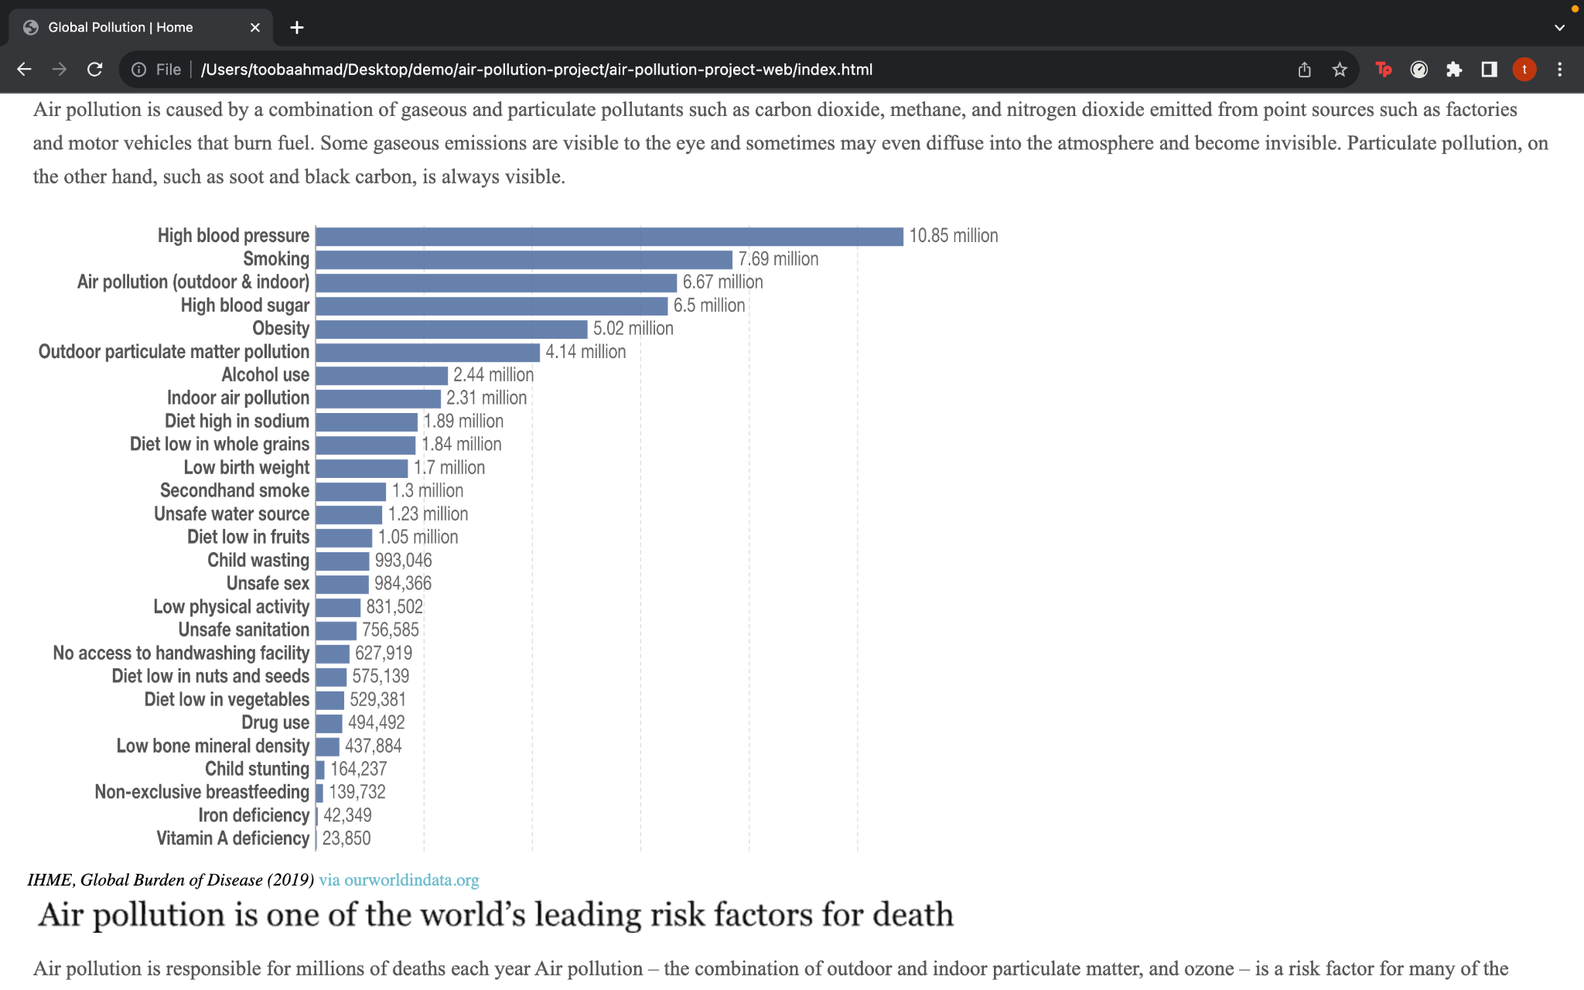
Death Analysis graph
Notes:
Home This chart is shown for the global total and only shows us the history time period from 1990 to 2019. Air pollution is one of the leading risk factors for death. In low-income countries, it is often very near the top of the list (or is the leading risk factor). Air pollution is responsible for millions of deaths each year.
In the graph we can see that the air pollution comes on number 3. Where the combination of outdoor and indoor particulate matter, and ozone – is a risk factor for many of the leading causes of death including heart disease, stroke, lower respiratory infections, lung cancer, diabetes and chronic obstructive pulmonary disease (COPD).

Slide 15
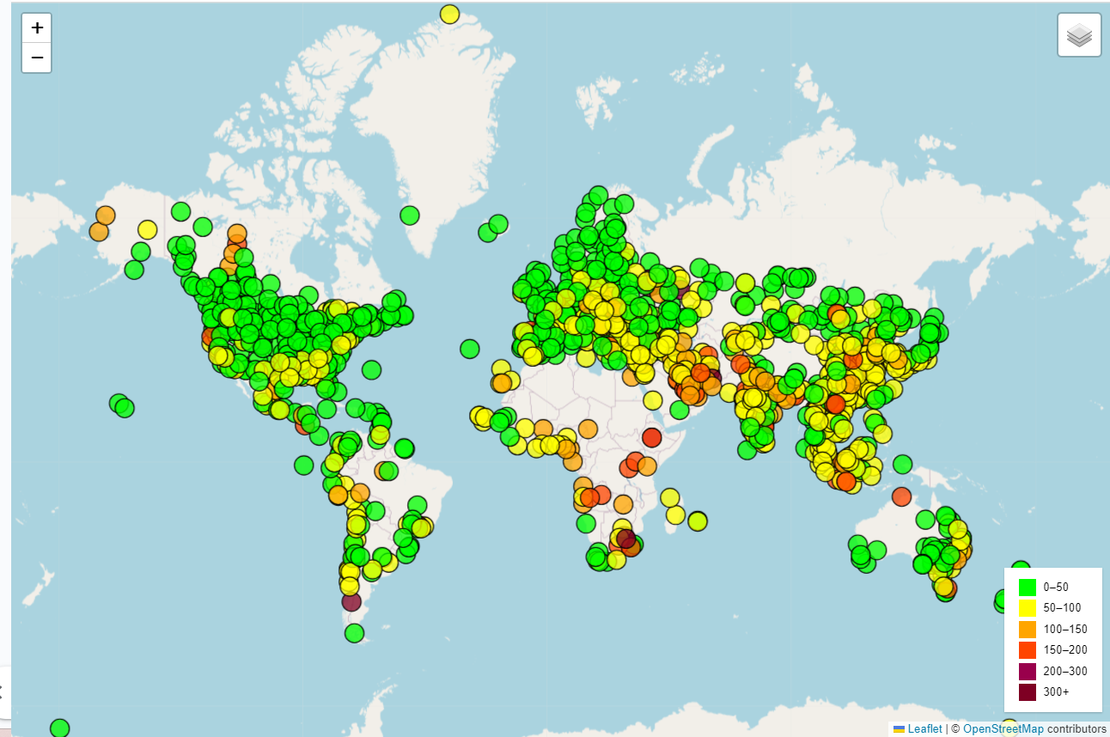
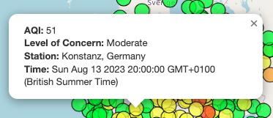
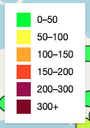
Leaflet Map
Popup information:
Legend (Air Quality Index):
Notes:
Map Next, the Leaflet library was used in JavaScript to create a map of live air quality data. Each circle represents a station and the colour relates to the Air Quality Index based on the standard ranges. When a circle is clicked, a popup appears detailing the station name, the time and the AQI. It also calculates and displays the level of concern based on the AQI ranges.

Slide 16
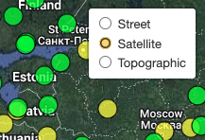
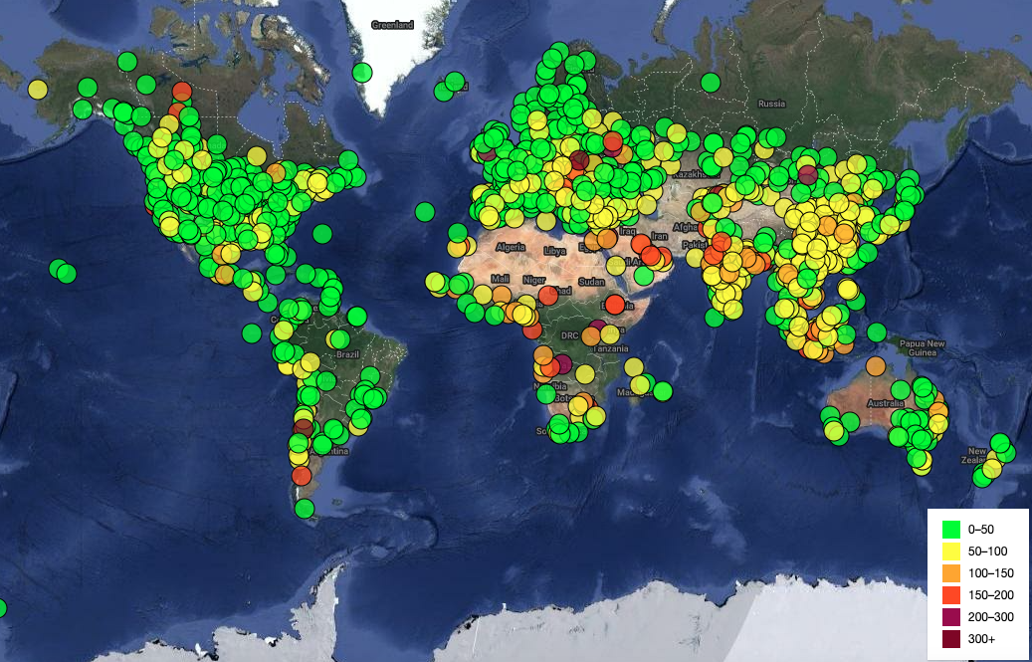
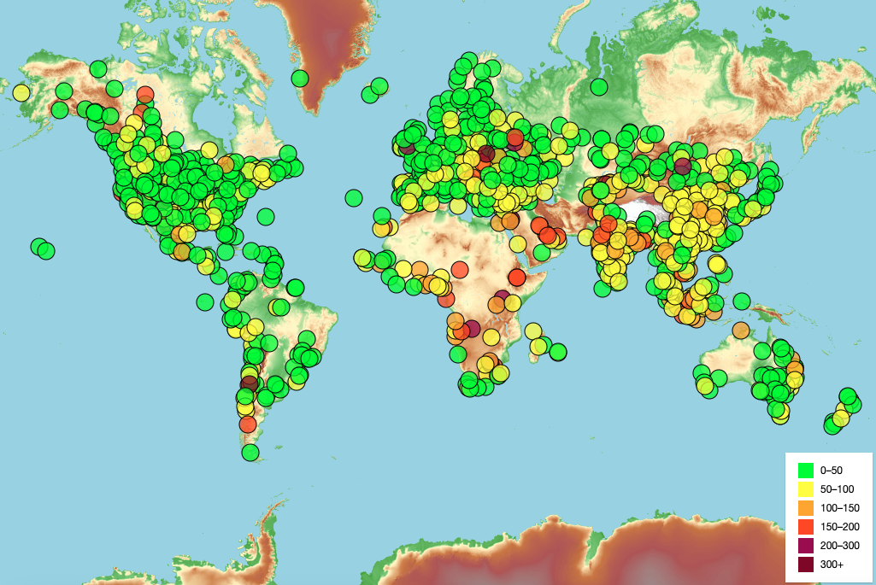
Leaflet Map
Layer control:
Notes:
Map The map also features layer control to allow the user to toggle between three base maps: street, satellite and topographic.

Slide 17
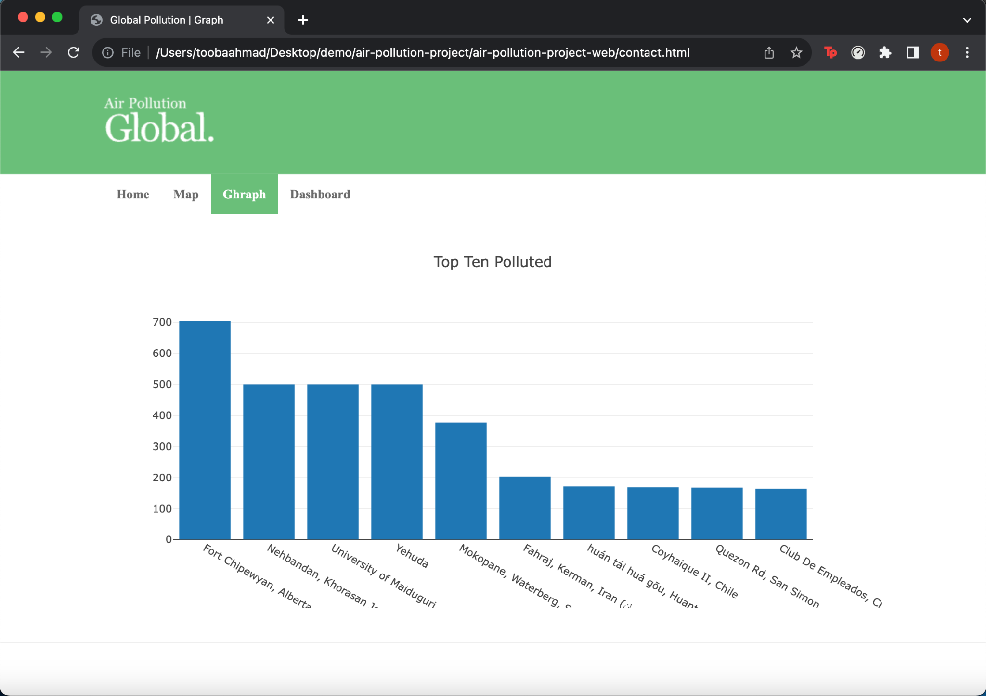
Website Pollution Analysis
Notes:
Graph - The bar chart demonstrates the Ten most polluted stations which are extracted from the data sets

Slide 18
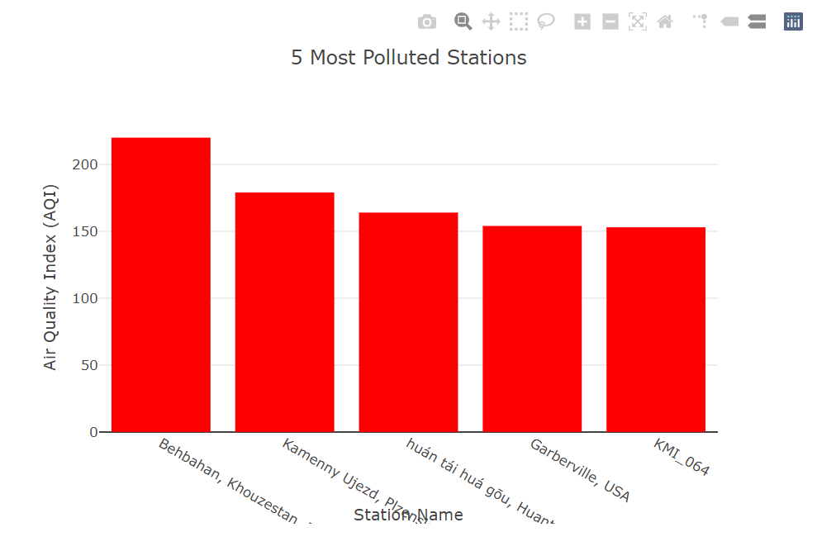
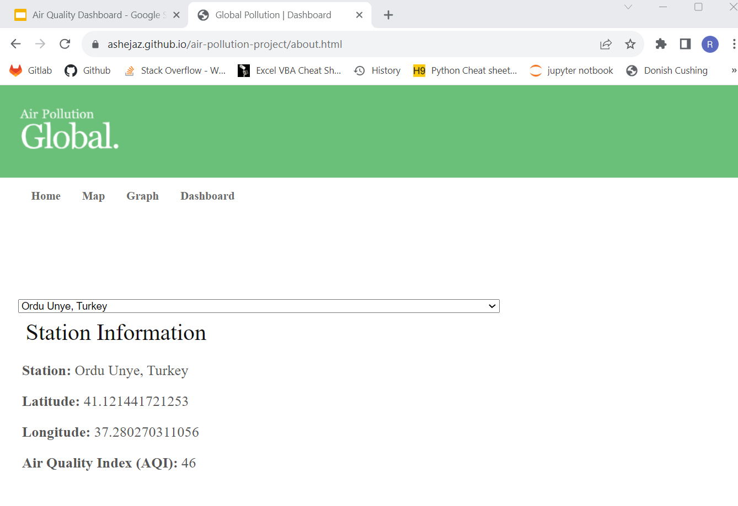
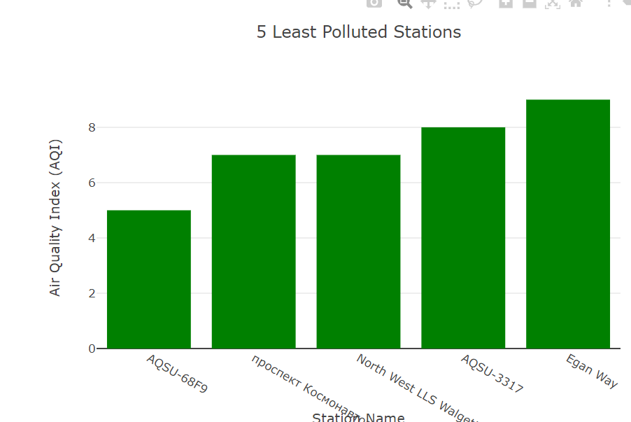
Dashboard
Notes:
Dashboard Finally, we created a simple dashboard with a dropdown list of all stations in the dataset. When a station is selected, an information box populates the station name, lat long coordinates and AQI. We also have two charts similar to the one shown before, displaying the 5 most polluted and 5 least polluted stations from the dataset.

Slide 19
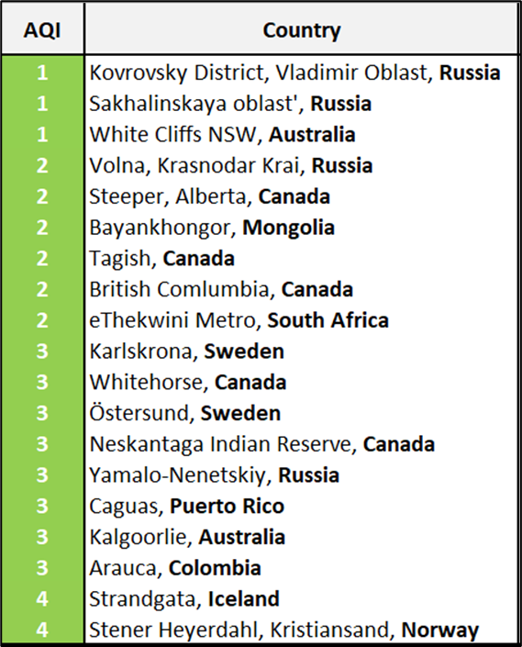
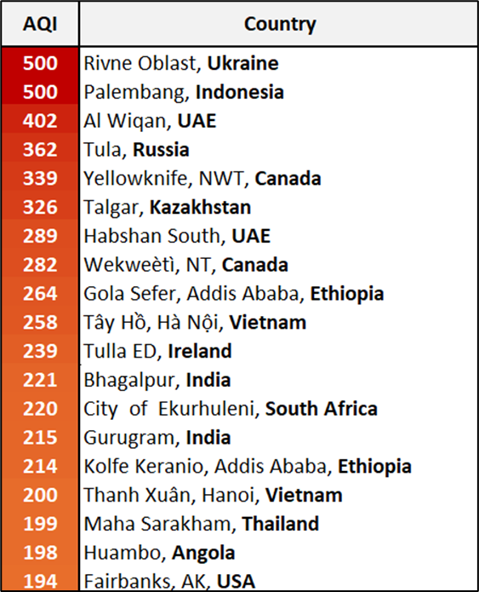
Top 20 Countries
with the highest and lowest AQI
Lowest AQI
Highest AQI
This data was collected on 11/08/2023, however AQI is updated Daily
Notes:
The AQI is updated daily. The table shows the top 20 countries with highest and lowest AQI as of 11th August 2023 showing
Kovrovsky District, Vladimir Oblast, Russia: 1, Sakhalinskaya oblast', Russia: 1, White Cliffs NSW, Australia:1
Had the lowest AQI indicated in green
Rivne Oblast, Ukraine: 500, Palembang, Indonesia: 500, Al Wiqan, UAE: 402
Had the highest AQI indicated in red

Slide 20
Conclusion
We have successfully managed to visualise and plot air pollution data and have identified hotspots.
The general trend seems to be that more industrialised countries have the highest AQI values. If we had more time and opportunity, we would explore this relationship further.
We could also potentially explore trends in specific pollutants as well as seasonal trends in air quality.
The insights gained from the data analysis can also be used to raise public awareness about air pollution's impact.
Notes:
1.Through data analysis, we were able to pinpoint pollution hotspots—areas with consistently high AQI values. This information is valuable for local authorities and environmental agencies to target interventions and regulations effectively.
2.By analyzing the latitude and longitude data in the CSV, we gained insights into the global distribution of pollution. We were able to identify areas with high pollution levels and understand the regions most affected by poor air quality
3.Categorizing AQI values into different air quality levels (Good, Moderate, Unhealthy, etc.) allowed us to understand the proportion of time different areas experience varying levels of air quality. This insight aids in understanding the prevalence of different pollution conditions.
4.The insights gained from the data analysis can also be used to raise public awareness about air pollution's impact. Clear visualizations and easy-to-understand information can empower individuals to take steps to protect their health and advocate for cleaner air.
5.The project allowed us to validate the effectiveness of existing air quality regulations and interventions. By comparing AQI trends before and after certain regulations were implemented, we can assess their impact on pollution levels.

Slide 21
Thank you for Listening
Notes:
Thank you for listening. We welcome any feedback and any questions?

